Slide 1

App design Guest speaker
Creating a Top 5 Health/Fitness app using PhoneGap Build
Matt Netkow
Developer/Founder, Netkosoft
www.netkow.com
@dotNetkow
matt.netkow@gmail.com

Slide 2
About me
Senior Developer for The SAVO Group – 5 years
Sales Productivity SaaS
Backend .NET C# development: user/document automation, tools
Mobile app development side projects - Netkosoft
Focus on front-end development
Entirely PhoneGap-based, HTML5 apps
Team of Two (Partnered with Graphic Designer)
Blog about technology, programming, PhoneGap at netkow.com

Slide 3
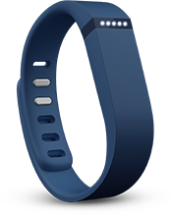


Fitwatchr: advanced fitbit activity tracker
+
=
Fitbit user Weight Watchers member Fitwatchr
Notable Features:
Challenging calorie tracking
Focus on motivational weight loss
Available for iOS, Android, and Windows Phone 8
Price varies: from $0.99 to $2.99
10,000 users in 1 year

Slide 4



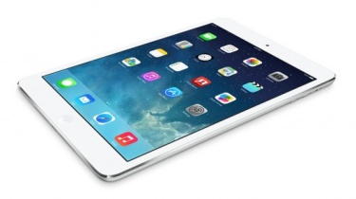
Tools
Sublime Text 2:
development
PhoneGap Build:
Cloud-based PhoneGap service
Native apps created for you!
Kendo UI Mobile for PhoneGap:
Automatic platform styling
Fast implementation
Core features now open-source!
Current Test Devices:
iPad mini Retina
Samsung Galaxy S3
Lumia 1020

Slide 5
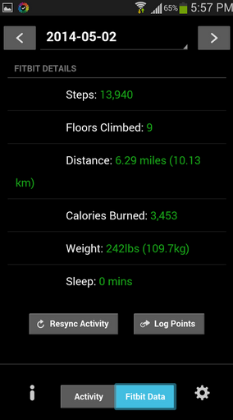
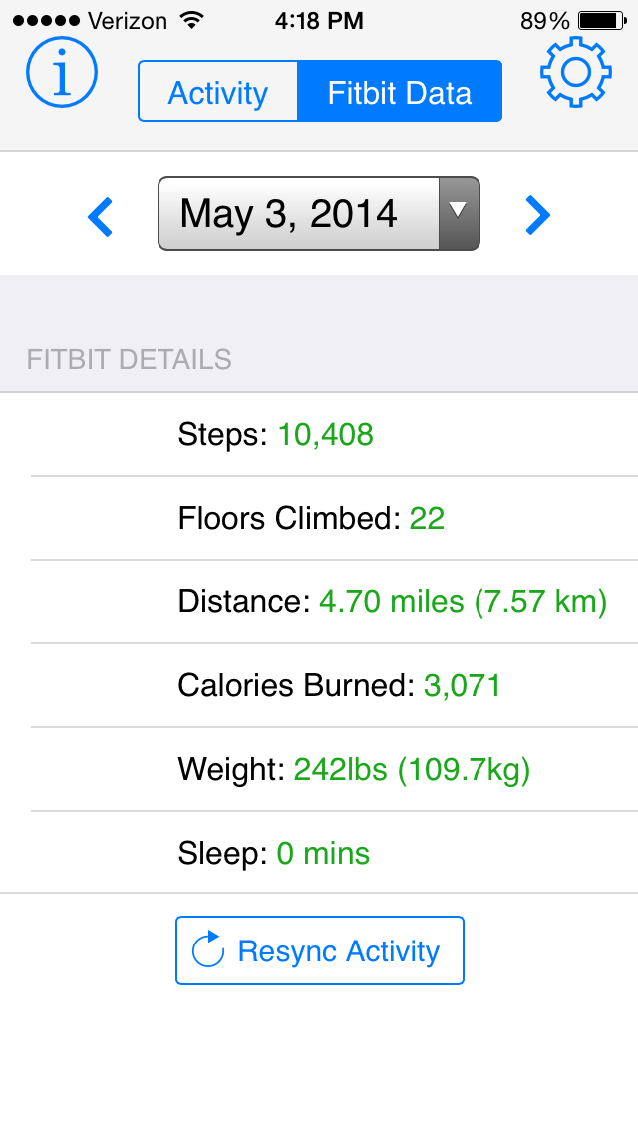
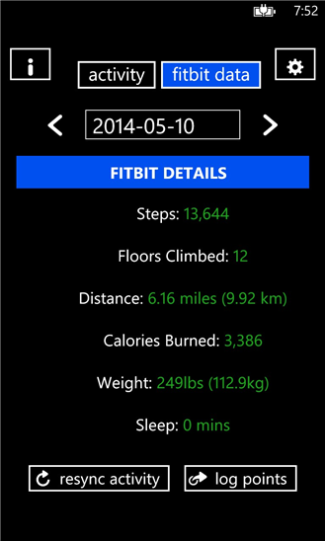
Platform Versions
Android iPhone Windows Phone

Slide 6
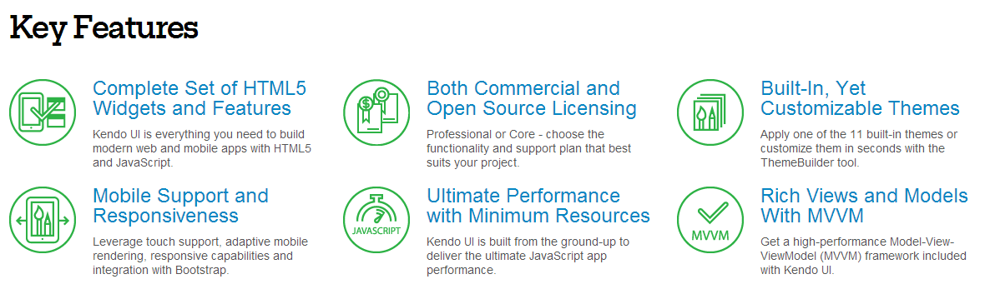
Kendo UI

Slide 7
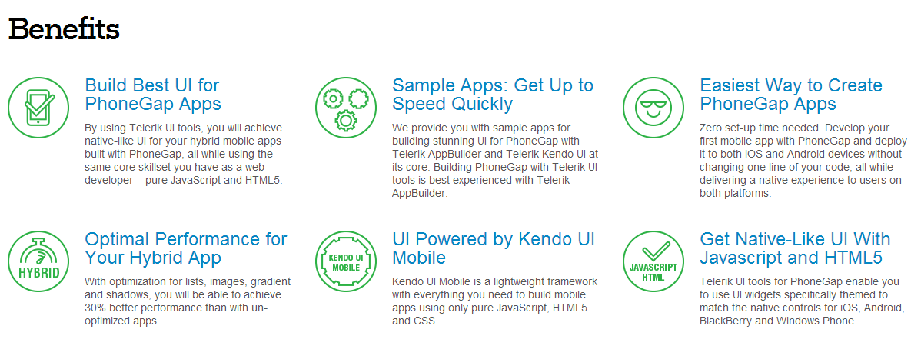
Kendo UI Mobile

Slide 8
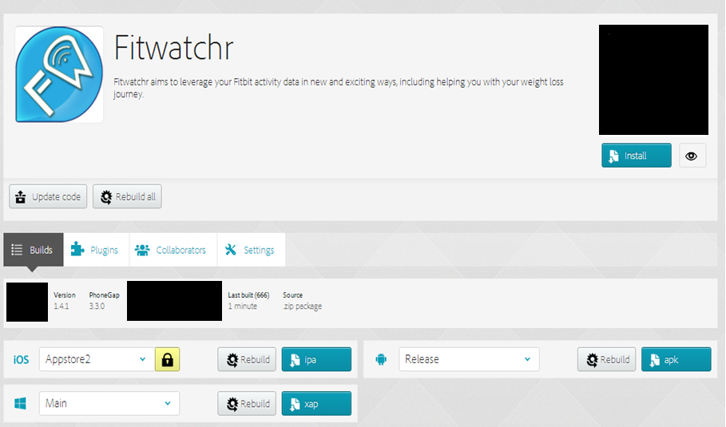
NOTABLE PHONEGAP BUILD FEATURES
Easily build multiple versions of app from same codebase:

Slide 9
Notable phonegap build features
Plugins
Fill in missing native functionality:
Camera interaction
In-app Browser
Google Analytics
Hydration
Automatically deploy new app versions to devices
Useful individually or with a team
Remote debugging
Review app code, storage, etc. all in real-time
Debug plugin behavior

Slide 10
Conclusion / thoughts
Great time to invest in web skills
Multitude of devices
Significant Adobe-backed investments
Better and better tooling:
PhoneGap Developer App
Brackets
Buy at least one test device
Hint: Start with your own phone!
Kendo UI Mobile
For designers and non-designers alike!

Slide 11
Questions?
Matt Netkow
Developer/Founder, Netkosoft
www.netkow.com
@dotNetkow
matt.netkow@gmail.com
PhoneGap Blog Guest post

